Slide 1
Neural Turing Machine

Slide 2
Agenda
What is Neural Turing Machine ?
Working Principle

Slide 3
What is Neural Turing Machine ?
A Neural Turing Machine is a working memory neural network model. It couples a neural network architecture with external memory resources.
The whole architecture is differentiable end-to-end with gradient descent. The models can infer tasks such as copying, sorting and associative recall.

Slide 4
What is Neural Turing Machine ?
A Neural Turing Machine (NTM) architecture contains two basic components: a neural network controller and a memory bank. The Figure presents a high-level diagram of the NTM architecture.
Like most neural networks, the controller interacts with the external world via input and output vectors.
Unlike a standard network, it also interacts with a memory matrix using selective read and write operations.
By analogy to the Turing machine we refer to the network outputs that parameterise these operations as “heads.”

Slide 5
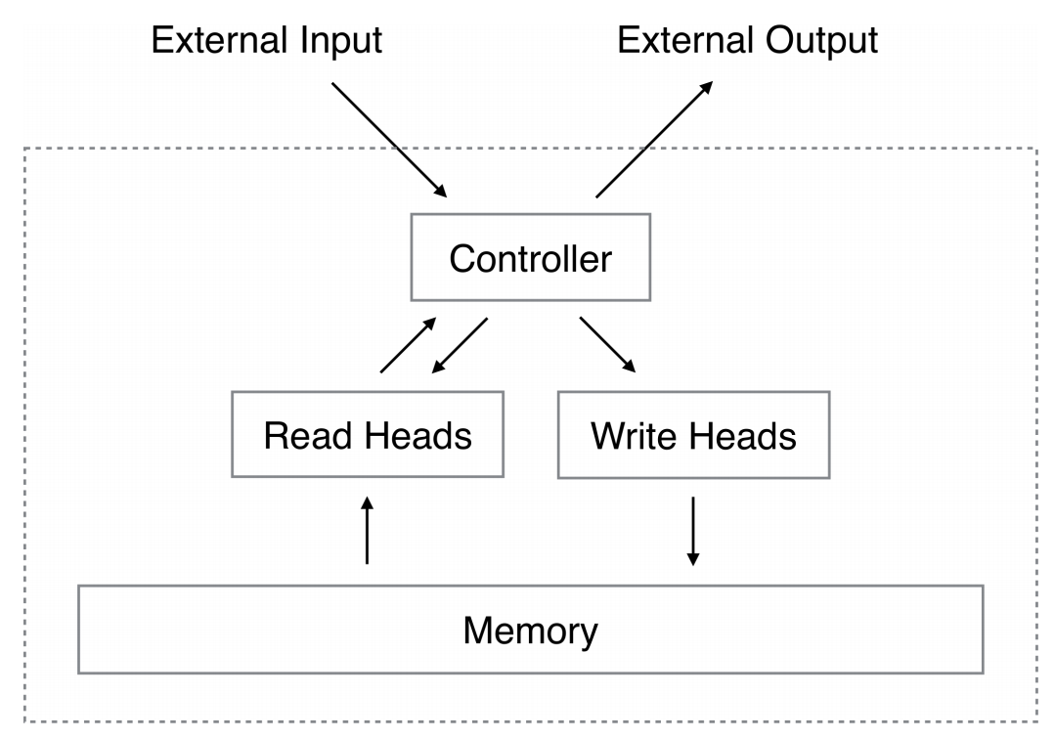

Slide 6
Working Principle
Every component of the architecture is differentiable. This is achieved by defining 'blurry' read and write operations that interact to a greater or lesser degree with all the elements in memory
The degree of blurriness is determined by an attentional “focus” mechanism that constrains each read and write operation to interact with a small portion of the memory, while ignoring the rest.
Because interaction with the memory is highly sparse, the NTM is biased towards storing data without interference.

Slide 7
Working Principle
The memory location brought into attentional focus is determined by specialized outputs emitted by the heads.
These outputs define a normalised weighting over the rows in the memory matrix (referred to as memory “locations”).
Each weighting, one per read or write head, defines the degree to which the head reads or writes at each location.
A head can thereby attend sharply to the memory at a single location or weakly to the memory at many locations

Slide 8
Contd..
If a neural network has been likened to a brain, then this is like giving the brain a working memory.
The network itself learns how best to use its memory when learning a solution to a given problem.
An NTM trained on a copy task where the goal was to output a copy of an input sequence, learned a copy algorithm.
By analysing the network and the interaction between the controller and the memory,

Slide 9
pseudocode
initialise: move head to start location
while input delimiter not seen do
receive input vector
write input to head location
increment head location by 1
end while
return head to start location
while true do
read output vector from head location
emit output
increment head location by 1
end while

Slide 10
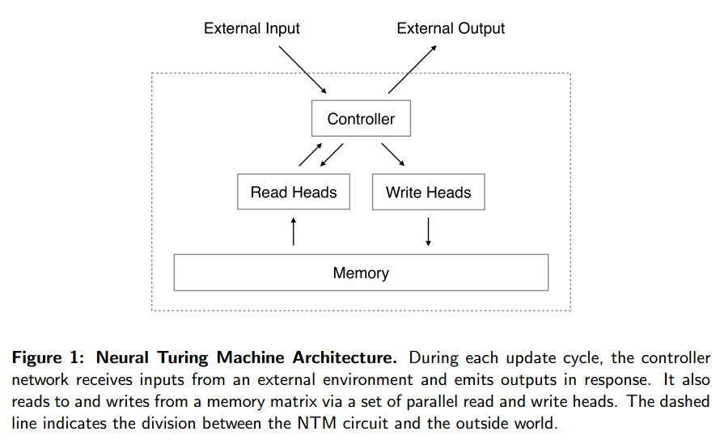
How to Build a Neural Turing Machine

Slide 11
Contd…
First of all you need a controller network that will receive inputs and produce outputs just like a regular neural network. A good choice for this controller network is a Recurrent Neural Network (RNN).
RNNs have dynamic state – the internal network state is evolved as a function of the current state and the input to the system.
This enables context-dependent computation, whereby a signal entering at a given moment can alter the behaviour of the network at a later moment.
The authors use a type of RNN called a Long Short-Term Memory architecture (LSTM). They also experimented with using feedforward networks.

Slide 12
Contd…
We achieved this by defining ‘blurry’ read and write operations that interact to a greater or lesser degree with all the elements in memory (rather than addressing a single element, as in a normal Turing machine or digital computer).
The degree of blurriness is determined by an attentional “focus” mechanism that constrains each read and write operation to interact with a small portion of the memory, while ignoring the rest.
Because interaction with the memory is highly sparse, the NTM is biased towards storing data without interference.

Slide 13
Contd…
Memory is just another matrix, with each row in the matrix representing a memory ‘location.’ The read and write heads emit a weighting vector with one component for each location. Imagine there are 10 memory locations.
Then the weighting vector [0,0,0,1,0,0,0,0,0,0] would have the effect of focusing the memory operation sharply on location 3, whereas a weighting vector [0,0.2,0.5,0.8,0.5,0.2,0,0,0,0] attends weakly to the memory across a number of locations (still centred around location 3 in this example).
A read is simply the convex combination of the memory matrix and weighting vector.

Slide 14

Writes are decomposed into two parts: an erase followed by an add. Given a weighting vector w_{i} emitted by a write head at time t, along with an erase vector e_{i} whose M elements all lie in the range (0,1), the memory vectors M_{t-1}(I) from the previous time-step are modified as follows:
Where 1 is a row vector of all 1s, and multiplication against the memory location acts pointwise.
Therefore, the elements of a memory location are reset to zero only if both the weighting at the location and the erase element are one; if either the weighting or the erase is zero, the memory is left unchanged. When multiple write heads are present, the erasures can be performed in any order, as multiplication is commutative.

Slide 15

Each write head also produces an M-length add vector, a_{i}, which is added to the memory after the erase step:
Since both erase and add are differentiable, the composite write operation is differentiable too.
These weightings arise by combining two addressing mechanisms with complementary facilities.
The first mechanism, “content-based addressing,” focuses attention on locations based on the similarity between their current values and values emitted by the controller.
The advantage of content-based addressing is that retrieval is simple, merely requiring the controller to produce an approximation to a part of the stored data, which is then compared to memory to yield the exact stored value.

Slide 16
content-based addressing
For content-based addressing the head (either read or write) produces an M length key vector, which is compared to each memory location vector by a similarity measure to produce the normalised weighting. Thus it focuses on the most similar memory locations.

Slide 17
Location-based addressing mechanism
The second mechanism is location-based addressing…
The location-based addressing mechanism is designed to facilitate both simple iteration across the locations of the memory and random-access jumps. It does so by implementing a rotational shift of a weighting. For example, if the current weighting focuses entirely on a single location, a rotation of 1 would shift the focus to the next location. A negative shift would move the weighting in the opposite direction.

Slide 18
combined addressing solution
The combined addressing solution works as follows. Firstly the content-addressing weightings are calculated. Then these weightings are blended with those from the previous time-step according to an interpolation gate scalar g ∈ (0,1) emitted by each head to produce the gated weighting.
w_{t}^{g} = g_{t}w_{t}^{c} + (1 – g_{t})w_{t-1}

Slide 19
The heads then produce a shift weighting that defines a normalised distribution over the allowed integer shifts (for the location addressing part).
For example, if shifts between -1 and 1 are allowed, s_{t} has three elements corresponding to the degree to which shifts of -1, 0 and 1 are performed. The simplest way to define the shift weightings is to use a softmax layer of the appropriate size attached to the controller.

Slide 20
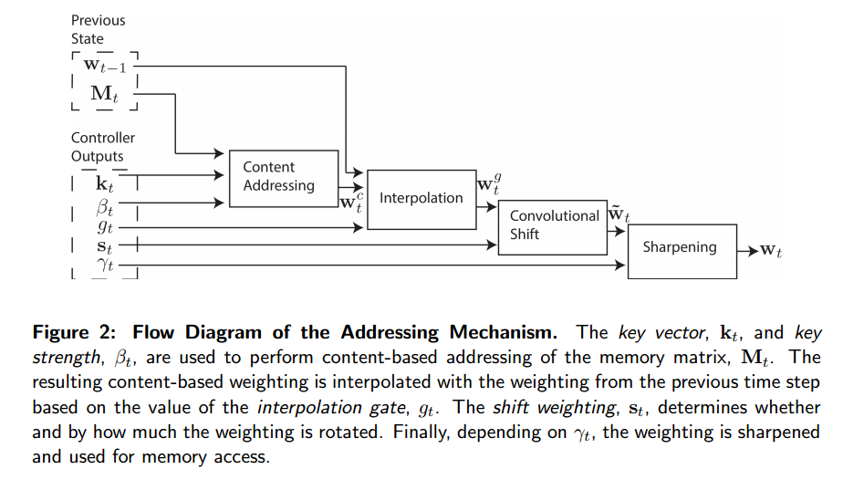

Slide 21
Thank you

